Slide 1




AUTOMATIC CAR PARKING TOLLGATE SYSTEM
P.VINEESHA - 22881A12A5
R.HARIKA - 22881A12A7
R. SAHITHI – 22881A12B0

Slide 2
INTRODUCTION
This project aims to design and implement a fully automated toll gate system that leverages the capabilities of Arduino microcontrollers to manage and streamline vehicle entry and exit in parking facilities. The system incorporates several key components: an Arduino board, readers, sensors, and actuators. Sensors detect vehicle presence, and actuators control the barrier gate mechanism

Slide 3
PROJECT DESCRIPTION
This project focuses on developing an automatic toll gate system that utilizes an Arduino microcontroller, ultrasonic sensors, and servo motors to streamline vehicle entry and exit in parking areas. The primary objective is to design a system that can detect the presence of a car and automatically control the toll gate, enhancing both efficiency and user convenience.

Slide 4


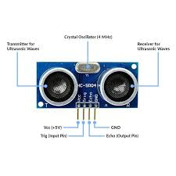
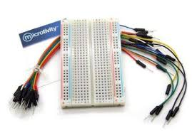
COMPONENTS UTILIZED:
ARDUINO
ULTRASONIC SENSOR
SERVO MOTOR
BREADBOARD &
JUMPER WIRES

Slide 5
WORKING
THE SYSTEM WORKS BY USING THE ULTRASONIC SENSOR TO DETECT THE PRESENCE OF A CAR. WHEN A CAR IS DETECTED AT A CERTAIN DISTANCE, THE SERVO MOTOR, WHICH ACTS AS THE GATE, WILL OPEN. AFTER A SHORT DELAY, ALLOWING THE CAR TO PASS THROUGH, THE SERVO MOTOR WILL CLOSE THE GATE.

Slide 6
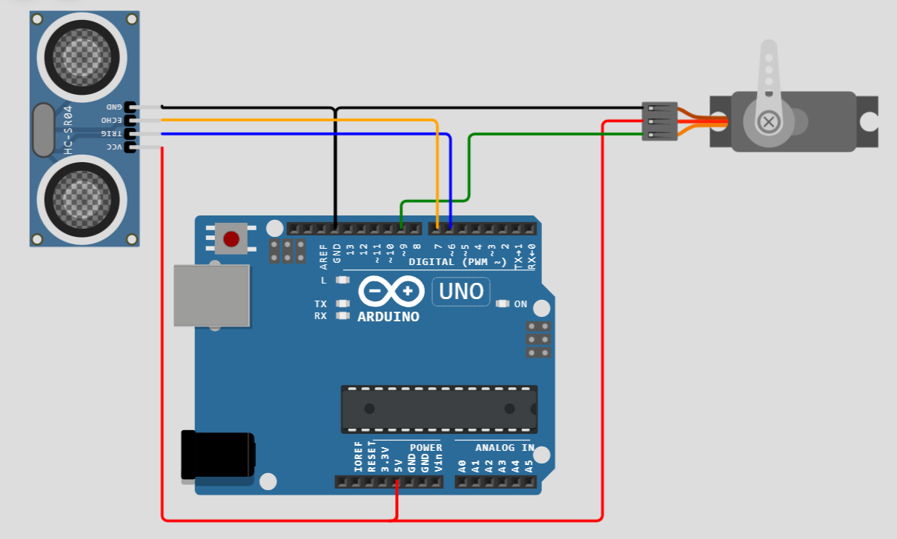
CIRCUIT CONNECTIONS
TRIGGER PIN --- DIGITAL PIN 6
ECHO PIN --- DIGITAL PIN 7
VCC --- 5V
GND --- GND
01 - BRANDING
03 - SOCIAL MEDIA

Slide 7
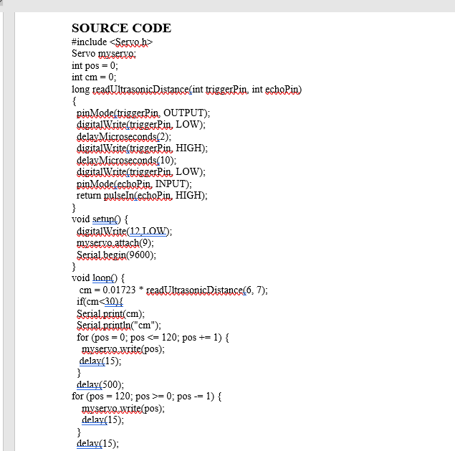

Slide 8







ADVANTAGES
REDUCE TRAFFIC CONGESTION AND WAITING TIMES AT TOLL PLAZAS COMPARED TO MANUAL SYSTEMS
The system can manage vehicle entry and exit automatically, simplifying the parking and tolling process
toll tax system using Arduino ultrasonic sensors eliminates the need for toll booth operators to manually collect tolls from drivers, which increases efficiency and reduces the waiting time for drivers
Automated systems can minimize human error, reducing the likelihood of accidents during parking and toll processing

Slide 9

CONCLUSION:
AN AUTOMATIC CAR PARKING TOOL GATE SYSTEM USING ARDUINO, A SERVO MOTOR, AND AN ULTRASONIC SENSOR IS AN EFFICIENT SOLUTION FOR AUTOMATING PARKING GATES. THE ULTRASONIC SENSOR DETECTS AN APPROACHING VEHICLE AND SENDS DATA TO THE ARDUINO, WHICH THEN CONTROLS THE SERVO MOTOR TO OPEN OR CLOSE THE GATE. THIS SYSTEM ENHANCES PARKING MANAGEMENT BY PROVIDING QUICK, RELIABLE ACCESS CONTROL, REDUCING THE NEED FOR MANUAL INTERVENTION. IT IS COST-EFFECTIVE, EASY TO IMPLEMENT, AND IMPROVES SECURITY AND CONVENIENCE

Slide 10








Thank you !

